Slide 1

Customer Shopping Behavior Analysis
Uncovering insights from transactional data to guide strategic business decisions.

Slide 2




Project Overview
Data Source
Goal
Outcome
3,900 purchases across categories.
Uncover spending patterns, segments, preferences.
Guide strategic business decisions.

Slide 3

Dataset Summary
Rows: 3,900
Columns: 18
Key Features
Customer demographics
Purchase details
Shopping behavior

Slide 4
Exploratory Data Analysis (Python)
01
02
03
Data Loading & Exploration
Missing Data Handling
Column Standardization
Pandas for import, df.info(), .describe() for summary.
Imputed Review Rating using median per category.
Renamed columns to snake_case.
04
05
Feature Engineering
Database Integration
Created age_group and purchase_frequency_days.
Loaded cleaned data to PostgreSQL for SQL analysis.

Slide 5
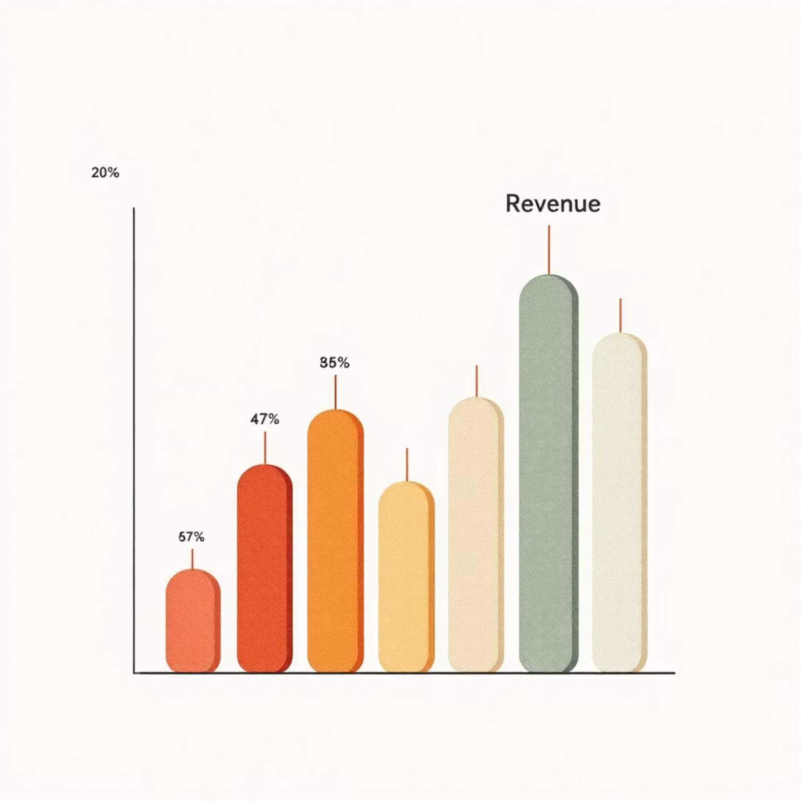
Key SQL Insights: Revenue & Discounts
Revenue by Gender
High-Spending Discount Users
Female
75191
Identified 839 customers who used discounts but spent above average.
Male
157890
Male customers generated significantly higher revenue.

Slide 6
Key SQL Insights: Products & Shipping
Top 5 Products by Rating
Shipping Type Comparison
Gloves
3.86
Standard
58.46
Sandals
3.84
Express
60.48
Boots
3.82
Express shipping users have slightly higher average purchase amounts.
Hat
3.80
Skirt
3.78

Slide 7



Key SQL Insights: Subscriptions & Discounts
Subscribers vs. Non-Subscribers
Non-subscribers (2847) contribute more total revenue ($170,436) than subscribers (1053) ($62,645).
Discount-Dependent Products
Hat (50%), Sneakers (49.66%), Coat (49.07%), Sweater (48.17%), Pants (47.37%) have highest discount rates.

Slide 8






Key SQL Insights: Customer Segmentation
New
83 Customers
Loyal
3116 Customers
Returning
701 Customers
Segmented customers based on purchase history for targeted strategies.

Slide 9
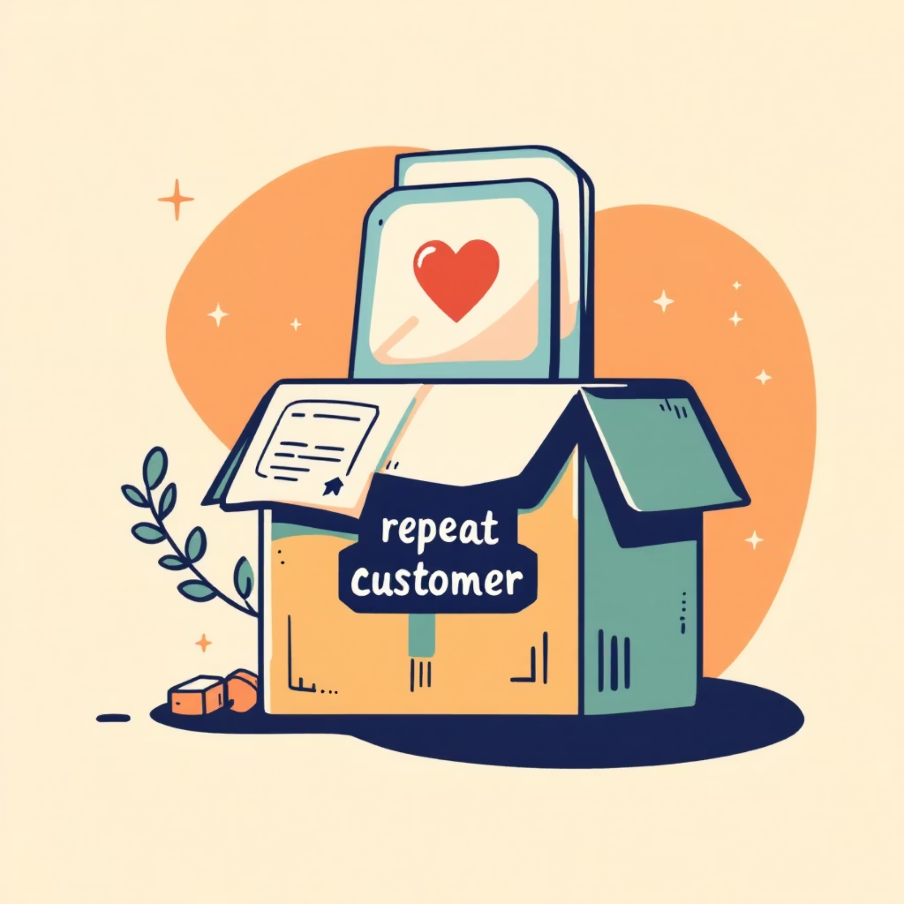
Key SQL Insights: Age & Repeat Buyers
Repeat Buyers & Subscriptions
Revenue by Age Group
958 repeat buyers (>5 purchases) are subscribers, 2518 are not.
Young Adult
62143
Middle-aged
59197
Adult
55978
Senior
55763
Young Adults contribute the highest revenue.

Slide 10

Business Recommendations
Boost Subscriptions
Promote exclusive benefits to increase subscriber base.
Customer Loyalty Programs
Reward repeat buyers to foster "Loyal" segment growth.
Review Discount Policy
Balance sales boosts with profit margin control.
Product Positioning
Highlight top-rated and best-selling products in campaigns.
Targeted Marketing
Focus on high-revenue age groups and express-shipping users.

